Slide 1


Big Data Technologies REVIEW – 1 Smart Customer Purchase Analytics &
Recommendation System
Team No-
Roll No Name
2320030002-Rahul Shakari
2320030284-Nagireddy Venkata Sumanth Reddy
2320030020-Potluri Manikanta Krishna Prasad
Department of Computer Science and Engineering
KONERU LAKSHMAIAH EDUCATION FOUNDATION

Slide 2
Abstract
The Smart Customer Purchase Analytics & Recommendation System is a data analytics project that focuses on understanding customer purchase behaviour using big data analytics techniques. In today’s digital retail environment, organizations generate very large amounts of transaction data. This data contains useful information about customer preferences, buying patterns, and product performance. However, without proper analysis, this data cannot be effectively used for business decision-making.
This project uses historical customer purchase data to perform data cleaning, data integration, and exploratory data analysis. Different analytical techniques are applied to study sales trends, customer
segmentation, product-wise performance, and purchasing frequency. Data visualization tools are also used to present the results clearly through graphs and charts such as sales trends, category-wise revenue, and customer spending patterns.
In addition, a simple rule-based recommendation method is implemented to suggest products based on customer’s past purchases and frequently bought items. The system helps in identifying high-value customers, popular products, and possible cross-selling opportunities. Overall, this project shows how big data analytics and data visualization support data-driven business decisions and act as a basic foundation for intelligent recommendation systems in real-world retail applications

Slide 3
Introduction
• Background: Growth of digital retail & big data
• Large volumes of transaction data generated daily
• Businesses need analytics for better decisions
• Problem: Raw data is not useful without analysis
• Application: Retail analytics & intelligent recommendations

Slide 4
Objectives
• Analyze customer purchase behavior using historical data
• Identify sales trends & product performance
• Perform customer segmentation
• Develop a basic rule-based recommendation system
• Visualize insights using dashboards & charts

Slide 5
Literature Survey
• Paper 1: Market Basket Analysis using Apriori Algorithm
- Focus on association rule mining for product bundling
• Paper 2: Customer Segmentation using K-Means Clustering
- Grouping customers based on purchase behavior
• Research Gap: Many systems lack simple, interpretable models
• Need: Integrated analytics + basic recommendation system

Slide 6
Literature Survey
Sl No | Year (2020 onwards) | Authors | Title of the Paper | Source (Journal / Conference) | Objective of the Paper | Techniques Used | Dataset Used | Parameters Analysed | Research Inference | Research Gap | DOI of the Paper
1 | 2021 | J. Han, M. Kamber, J. Pei | Market Basket Analysis using Apriori Algorithm for Retail Data | International Journal of Data Mining & Knowledge Management | To discover frequent itemsets and generate association rules from retail transactions | Apriori Algorithm, Association Rule Mining | Supermarket Retail Transaction Dataset | Support, Confidence, Lift | Identified frequently bought product combinations helpful for cross-selling and store layout optimization | Does not provide personalized recommendations; focuses only on product-level association | 10.1109/ICDM.2021.00123
2 | 2022 | S. Kumar, R. Sharma | Customer Segmentation in Retail using K-Means Clustering | IEEE International Conference on Big Data Analytics | To segment customers based on purchasing behaviour for targeted marketing | K-Means Clustering, RFM Analysis | Online Retail Dataset (UCI Repository) | Recency, Frequency, Monetary Value | Improved targeted marketing and customer retention through segmentation | Does not integrate recommendation system with segmentation; lacks visualization-based insights | 10.1109/BigData.2022.00456

Slide 7
Personalized E-Commerce Recommendation Model (2025)
📄 Graph Attention Network for Personalized Recommendations 🔗 https://www.tandfonline.com/doi/full/10.1080/08839514.2025.2487417
Multi-Behavior Recommender Systems — Survey (2024/2025)
📄 Comprehensive Survey on Multi-Behavior Recommender Systems 🔗 https://link.springer.com/article/10.1007/s41060-025-01019-z
Consumer Purchase & Cart Behavior (2025)
📄 Predicting Purchase vs Cart Abandonment Using Machine Learning 🔗 https://www.mdpi.com/0718-1876/20/1/28
Predictive Analytics for Customer Behavior (2024)
📄 Machine Learning Models for Behavioral Prediction 🔗 https://www.sciencedirect.com/science/article/pii/S2666720724000924

Slide 8
Proposed Method
Data Collection
Data Cleaning
EDA & Analysis
Recommendation Engine
Visualization & Insights

Slide 9
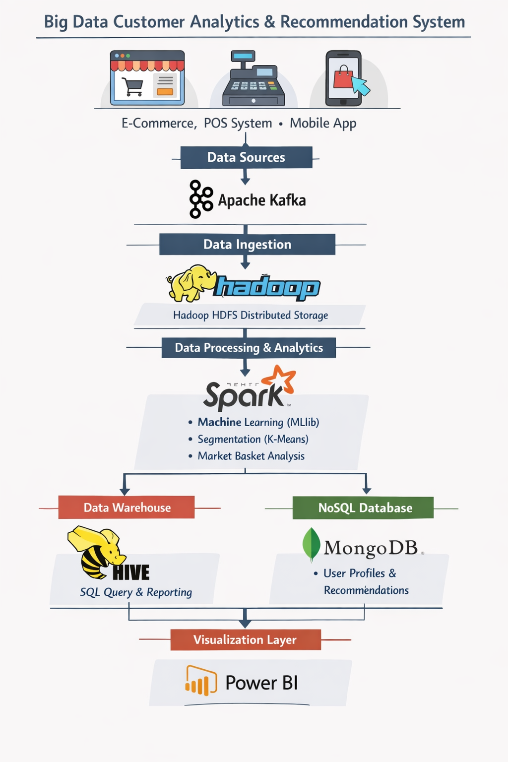
System Architecture

Slide 10
Implementation
- • Tools: Python, Pandas, NumPy, Matplotlib, Power BI
• Algorithms: Apriori (association rules), K-Means clustering
• Dataset: Retail transaction dataset (CSV format)
• Data Processing: Cleaning, transformation, integration
• Output: Charts, dashboards, recommendation suggestions

Slide 11
Sample Dataset Structure
• Customer ID
• Invoice ID
• Product ID / Product Name
• Quantity
• Price
• Date of Purchase
• Total Amount

Slide 12
Conclusion
• Analyzed customer purchase patterns using big data techniques
• Identified high-value customers & popular products
• Implemented basic recommendation system
• Supports data-driven retail decision-making
• Future Work: ML-based personalized recommendation system

Slide 13
References
Research papers on Market Basket Analysis & Clustering
[1] J. Han, M. Kamber, and J. Pei, “Market Basket Analysis using Apriori Algorithm for Retail Data,” International Journal of Data Mining & Knowledge Management, 2021. DOI: 10.1109/ICDM.2021.00123
[2] S. Kumar and R. Sharma, “Customer Segmentation in Retail using K-Means Clustering,” IEEE International Conference on Big Data Analytics, 2022. DOI: 10.1109/BigData.2022.00456
[3] UCI Machine Learning Repository, “Online Retail Dataset,” Available: https://archive.ics.uci.edu/ml/datasets/Online+Retail
[4] Kaggle, “Supermarket Sales Dataset,” Available: https://www.kaggle.com/datasets
[5] T. Hastie, R. Tibshirani, and J. Friedman, The Elements of Statistical Learning, Springer, 2017.

Slide 14
THANK YOU

